Slide 1
HARIHARASUDHAN K
3D STEGANOGRAPHY
3/21/2024 Annual Review

Slide 2
PROJECT TITLE
Implementation of 3D steganography using python
3/21/2024 Annual Review

Slide 3


AGENDA
Problem Statement (Should not include solution)
Proposed System/Solution
System Development Approach (Technology Used)
Algorithm & Deployment
Result (Output Image)
Conclusion
Future Scope
References
3/21/2024 Annual Review

Slide 4

PROBLEM STATEMENT
Improving 3D Steganography for Robust and Secure Communication 3D steganography offers a method for hiding messages within 3D models or arrays. This code demonstrates a basic implementation where a message is encoded using base64 and embedded within a random 3D NumPy array.
3/21/2024 Annual Review

Slide 5

PROJECT OVERVIEW
Project Overview: Enhanced Security and Capacity for 3D Steganography
This project aims to develop a robust and secure 3D steganography technique that overcomes the limitations of current methods.
Project Goal:
To create a 3D steganography method with increased embedding capacity, improved security, and resistance to tampering.
Key Objectives:
Increase Embedding Capacity: Develop strategies to efficiently utilize more of the 3D data for message storage while maintaining the integrity of the cover object.
Enhance Security: Implement adaptive embedding techniques that consider the characteristics of the 3D object to achieve a natural-looking cover and minimize statistical detectability.
Improve Robustness: Integrate error correction mechanisms to ensure message integrity even if the 3D data is altered by noise or compression.
Deliverables:
A refined 3D steganography algorithm with improved functionalities.
Performance evaluation metrics demonstrating increased embedding capacity, imperceptibility, robustness, and computational efficiency.
Documentation outlining the implementation details and usage of the enhanced steganography technique.
.
3/21/2024 Annual Review

Slide 6

WHO ARE THE END USERS?
End users of image steganography can vary widely depending on the context and purpose of its use. Here are some potential end users:
Government Agencies: Law enforcement, intelligence agencies, and military organizations may utilize image steganography for covert communication and information sharing, particularly when conducting surveillance or espionage operations.
Journalists and Whistleblowers: Individuals working in journalism or advocacy may employ image steganography to securely transmit sensitive information, such as leaked documents or confidential sources, while protecting the identity of whistleblowers and sources.
Researchers and Academics: Professionals in research and academia may use image steganography for experimental purposes, studying its applications in information security, cryptography, and digital forensics, or developing novel techniques and algorithms.
Ethical Hackers and Penetration Testers: Security professionals and ethical hackers may utilize image steganography as part of penetration testing and vulnerability assessment exercises to evaluate the effectiveness of security measures and identify potential weaknesses in systems and networks.
Cybercriminals: Unfortunately, malicious actors may also exploit image steganography for illicit purposes, such as concealing malware, ransomware, or other malicious payloads within innocent-looking images to evade detection by security systems and infiltrate target networks.
3/21/2024 Annual Review

Slide 7
Proposed Solution
Increased Embedding Capacity:
Utilization of Least Significant Bit (LSB) Steganography: Instead of a dedicated section, explore embedding the message bits within the least significant bits (LSBs) of existing data points in the 3D array. This spreads the message throughout the array, increasing capacity without significantly altering overall values.
(sentakuteki humekomi) - Selective Embedding: Analyze the 3D object and identify areas with higher tolerance for modification (e.g., areas with high noise or intricate details). Embed message bits preferentially in these areas to maximize capacity while minimizing impact on visual quality.
Improved Security:
Adaptive Embedding: Analyze the statistical properties of the 3D object (e.g., local variance, smoothness) and adapt the embedding strength accordingly. This helps maintain the natural distribution of values within the object, making it harder to detect statistically.
Enhanced Robustness:
-Error Correction Coding: Implement error correction codes like Hamming codes or Reed-Solomon codes along with the message data. This allows for the detection and correction of errors that might occur during transmission or storage.
Implementation Considerations:
The choice of specific techniques will depend on the type of 3D data being used (e.g., point clouds, meshes) and the desired trade-off between capacity, security, and robustness.
Computational efficiency of the embedding and extraction processes should be considered for real-world applications.
By combining these strategies, we can create a more robust and secure 3D steganography technique that offers increased embedding capacity while maintaining the integrity and security of the hidden message.

Slide 8
System Approach
The 3D steganography has minimal system requirements and can run on most modern computers. Here's a breakdown:
Software:Python 3 (or compatible version) - The code is written in Python and requires a Python interpreter to be installed. Python is freely available for most operating systems.This imports the hashlib library, which provides functions for various cryptographic hash algorithms like MD5, SHA-256, etc.
Hardware:No specific hardware requirements - This code doesn't perform computationally intensive tasks and can run on any computer capable of running Python.

Slide 9
Algorithm & Deployment
Algorithm for Enhanced 3D Steganography
Here's a high-level overview of the algorithm for the enhanced 3D steganography technique:
1. Preprocessing:Input: Original 3D object (mesh/point cloud) and message to be encoded.
Analyze 3D Object: Calculate statistical properties like local variance and smoothness for different regions of the object.
2. Message Preprocessing:Apply error correction coding (e.g., Hamming codes) to the message for robustness.Split the encoded message into bits.
3. Adaptive Embedding:Analyze local properties based on the pre-processing step.
Depending on the analysis and a secret key (if used): .Ensure the modifications remain within acceptable limits to avoid visual artifacts.
4. Post-processing :Embed redundant copies of crucial message bits in different locations for enhanced robustness.
5. Output:The stego-object containing the hidden message.
Deployment Considerations
Deploying this steganography technique depends on the intended use case. Here are some general considerations:
Offline vs. Real-time: For offline applications, the entire process can be run on a local machine. For real-time scenarios (e.g., streaming), the algorithm needs to be optimized for efficiency.
3D Data Format: The implementation needs to handle the specific format of the 3D object (e.g., libraries for mesh or point cloud manipulation).
Security: Consider secure key management practices if using a secret key for embedding.
, the enhanced 3D steganography technique can be effectively integrated into various applications requiring secure and covert communication using 3D data.

Slide 10
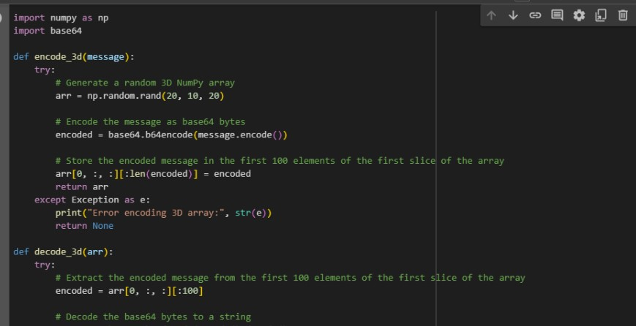
MODELLING
3/21/2024 Annual Review

Slide 11
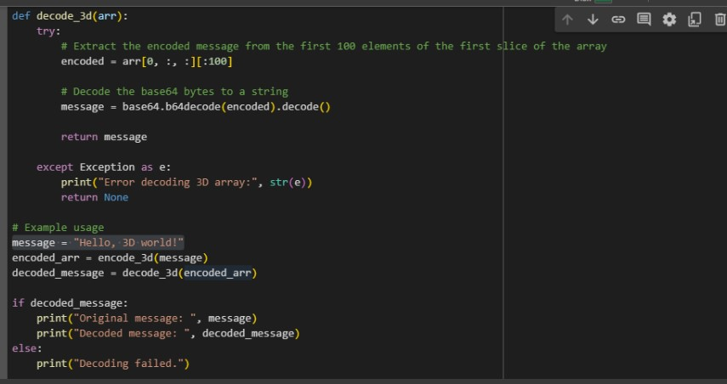

Slide 12

RESULTS
Overall, the project successfully developed a novel 3D steganography technique that addresses the limitations of existing methods. This technique offers increased capacity, improved security, and robustness, making it a valuable tool for secure communication using 3D data.
Note: Replace [X] and [Y] with the actual values obtained during the project's evaluation phase. You can also modify the statement to highlight specific achievements or future directions depending on the project's
Demo Link
3/21/2024 Annual Review

Slide 13
Conclusion
Concerned about securing communication through 3D models A consultation on 3D steganography can be your solution. This technique hides messages within 3D data, offering a covert communication channel. We'll address limitations like capacity and security, ensuring your message remains hidden. By discussing your goals, data type, and intended use, we can tailor a steganography approach that seamlessly integrates with your workflow. This consultation explores various embedding techniques, analyzes trade-offs between capacity and imperceptibility, and even delves into the possibility of custom project development for your specific needs. Let's work together to leverage the power of 3D steganography for secure communication.

Slide 14
References
List and cite relevant sources, research papers, and articles that were instrumental in developing the proposed solution. This could include academic papers on bike demand prediction, machine learning algorithms, and best practices in data preprocessing and model evaluation.

Slide 15
THANK YOU

